Slide 1





Slide 2


Soft Skills Foundation – Part 1
01
DAY
08-August-2022
Business Etiquettes
Presentation
Professionalism
Active Listening
Leadership
07
08
09
August

Slide 3

Linux Fundamentals
02
DAY
09-August-2022
Kernel
File Permission
File Owners
Linux Commands
Software
Cygwin Terminal
08
09
10
August

Slide 4

Linux Fundamentals
03
DAY
10-August-2022
Control Structures
Loops
09
10
If
Then
While
Break
11
Else
Fi
Continue
Do
August

Slide 5

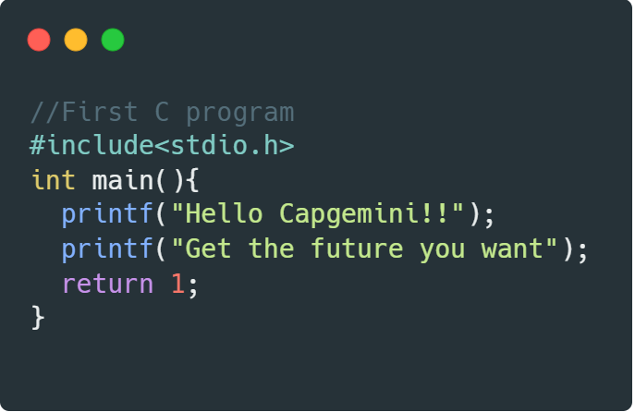
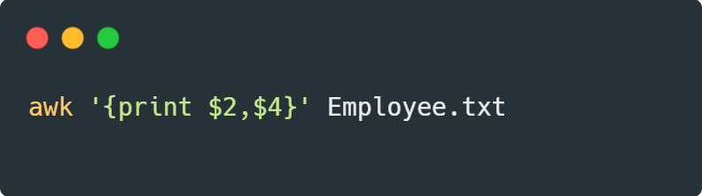
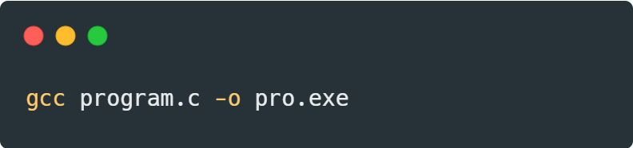
Programming in C + Tools
04
DAY
11-August-2022
10
11
12
August

Slide 6
Programming in C + Tools
05
DAY
12-August-2022
Loops – While & Do While
Switch Case
C-Tags
Pre & Post Increment & Decrement Operators
Precedence of Operators
Associativity of Operators
11
12
13
August

Slide 7
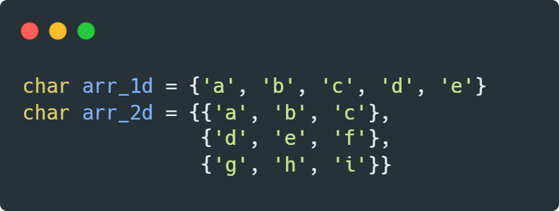
Programming in C + Tools
06
DAY
16-August-2022
1D Array
2D Array
a
b
c
d
e
a
b
c
15
0
1
2
3
4
00
01
02
16
d
e
f
10
11
12
17
g
h
i
20
21
22
August

Slide 8
THANK YOU

